Slide 1

CAPITAL

Slide 2
What is capital in accounting
Capital is any resources/assets received from the owner to use for the business.
Ejaj-Ur-Rahaman

Slide 3
What is capital in accounting
Capital refers to the financial resources or assets like cash, machinery, equipment and other resources. These are the assets that received from the owner.
Ejaj-Ur-Rahaman

Slide 4

Owner VS Business
Hope, you can remember that the owner and the business are separate entity. According to Economic Entity Principle we consider owner and business as separate entity. The owner and the business are not onebody, not same.
Ejaj-Ur-Rahaman
Notes:
ThingLink
The founders of Google, Larry Page and Sergey Brin

Slide 5
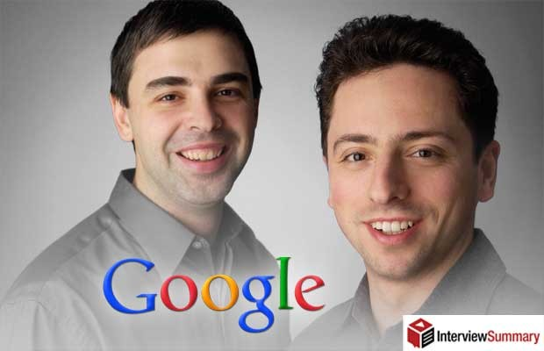



Business VS Owner
Ejaj-Ur-Rahaman
Notes:
ThingLink
The founders of Google, Larry Page and Sergey Brin
Hussain Elius, Fahim Saleh

Slide 6

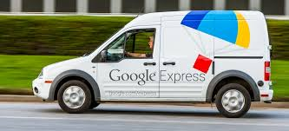

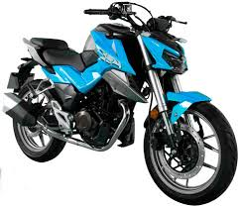
Business VS Owner
Ejaj-Ur-Rahaman
Notes:
ThingLink
The founders of Google, Larry Page and Sergey Brin

Slide 7
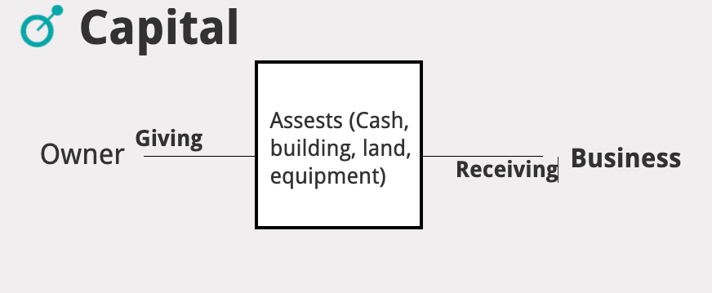

Slide 8
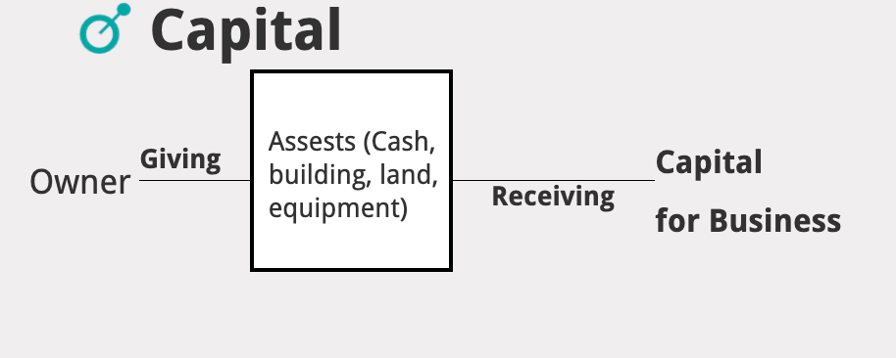

Slide 9

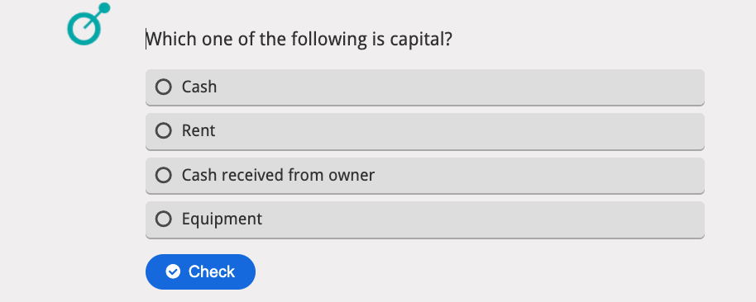
Q
U
I
Z

Slide 10
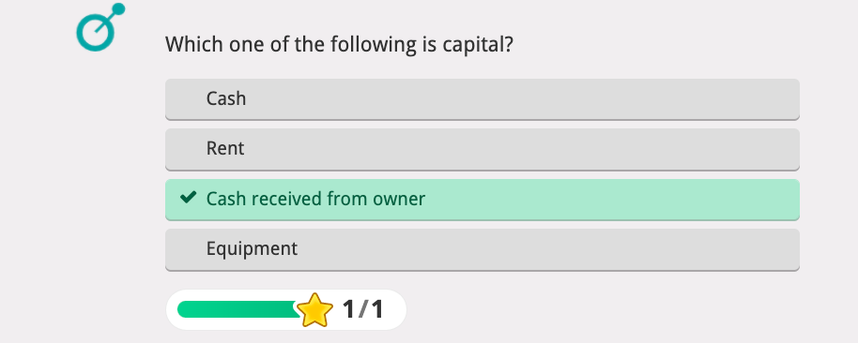
Q
U
I
Z

Slide 11
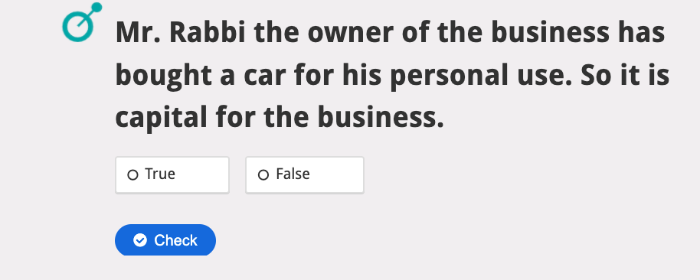
Q
U
I
Z

Slide 12
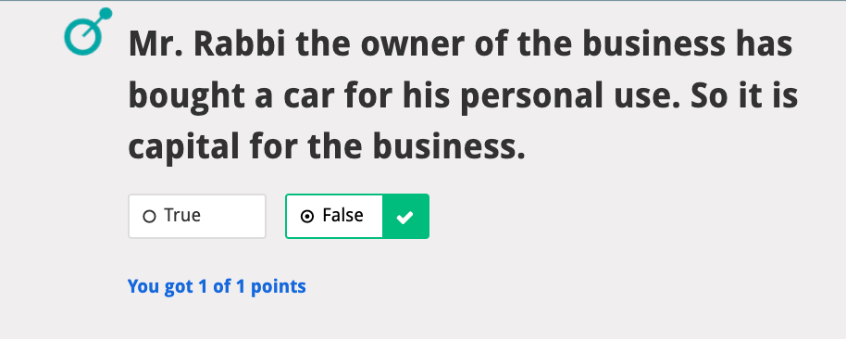
Q
U
I
Z

Slide 13
For more clarity :
Owner starts business by investing money. The money is capital for the business. Owner can invest additional assets e.g. equipment to business so it is also capital for the business. Anytime any asset given by the owner is capital.
Ejaj-Ur-Rahaman

